Slide 1
Numeric Data Types

Slide 2
Variables have TYPE
double myValue = 0.0;
int myInt = 1;
What is the value of a TYPE?
Why do we have it?

Slide 3
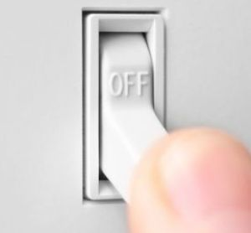
Reminder on Binary and Memory
Binary – two state system
1 for on
0 for off
Each 0 and 1 is called a bit
8 bits is called a byte
Contains 255 states (128+64+32+16+8+4+2+1)
1000 bytes is a kilobyte
1,000,000 bytes is a megabyte
A song is often 3-5 megabytes
Issues
What if I want negative numbers?
Sacrifice a bit for sign and center
255 states become, -128 to 127
What if you need more than that range?
0
0
1
1
1
1
1
0
1
1
2
0
0
0
0
1
0
This Photo by Unknown Author is licensed under CC BY-SA
4
1
0
0
1
8
0
0
0
0
1
16
0
0
0
0
1
32
0
0
0
0
1
64
0
0
0
0
1
128
1
Pro Tip
There is an interactive byte in zybooks. Play with it until you start to see it.

Slide 4
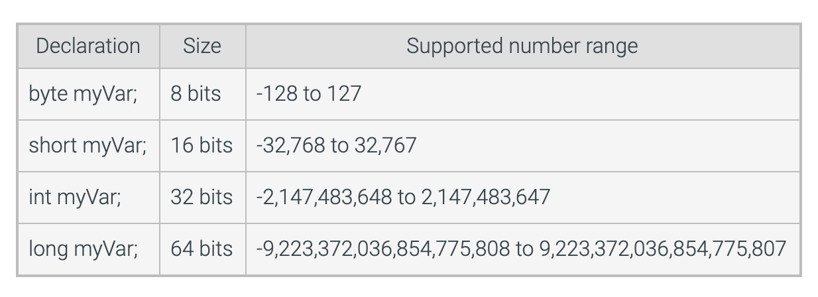
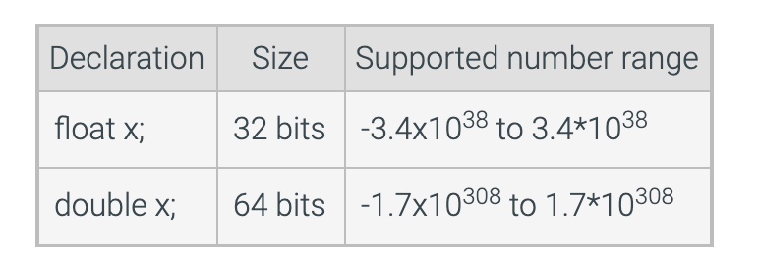
Numeric Types

Slide 5
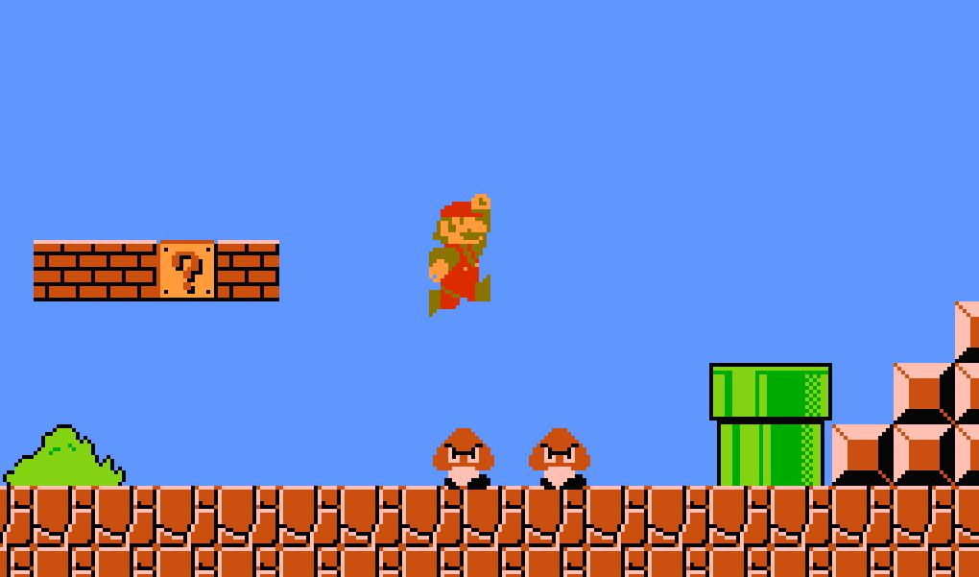
Why Different Types?
Numeric Types
byte
short
int
long
float
double
If you wanted to represent the national debt?
double
If you wanted to represent color codes on a limited memory system?
short or even byte (8-bit graphics!)
World population projected over time
long
Grades in a grade book for all students on campus?
float
Why use int for loops?
Processors are optimized for int, so if memory is not a concern, use that
8-bit graphics, only 255 color options

